Slide 1
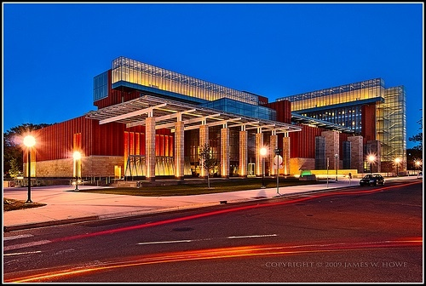
AMERICAN BUSINESS HISTORY
Dr. Mary Hinesly [hines-lee]

Slide 2
Before we start…
An Honest Look

Slide 3
Pandemic with the loss of loved ones Political Upheaval Social Injustice Systematic Racism is Everywhere in America This is about American Business History, repeating.
Our class, our time

Slide 4
This is all about YOU
What you can expect from me…

Slide 5
Tell me about you! Your Name (or nickname) Where home is or wish it was? A Fun Fact (most people do not know about you)
Exceptional TA’s – Jonathan & Rachel, then me☺

Slide 6
Breakout Tables Why did you take the class? What you hope to learn?
5-7 minutes - back to share with the class.

Slide 7
Syllabus
Questions?

Slide 8
Pre-Read
Discussion

Slide 9
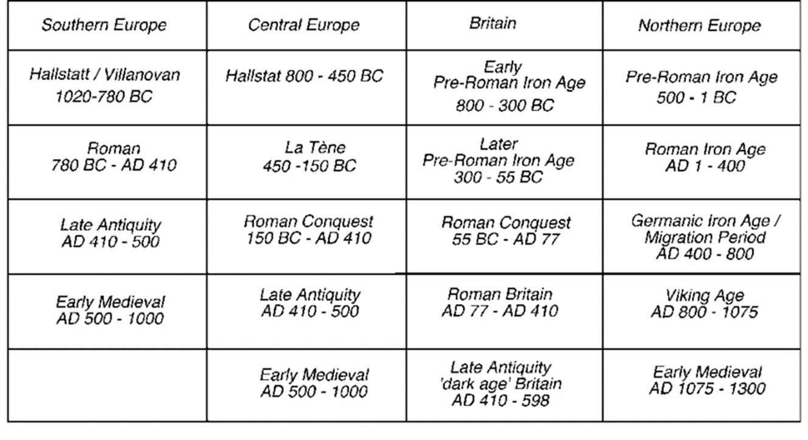
.
.

Slide 10
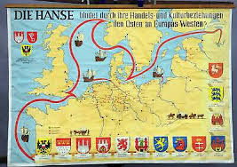
Hanseatic
The Hanseatic League (also known as Hansa, Hanse, 1356-1862 CE) was a federation of north German towns and cities formed in the 12th century CE to facilitate trade and protect mutual interests.
https://www.ancient.eu/Hanseatic_League/#:~:text=The%20Hanseatic%20League%20(also%20known,trade%20and%20protect%20mutual%20interests.

Slide 11
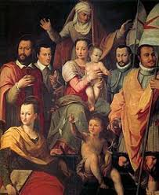

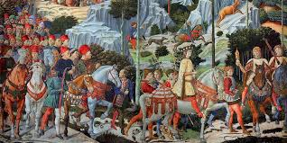
Medicis of Florence, Italy
The House of Medici was an Italian banking family and political dynasty. They began to gather prominence under Cosimo de' Medici in the Republic of Florence during the early 1400’s.

Slide 12
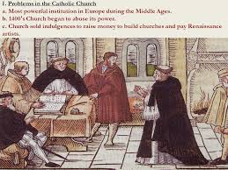
Catholic Church & Calvinism
In 1500 the Roman Catholic Church was all powerful in western Europe. There was no legal alternative. The Catholic Church jealously guarded its position and anybody who was deemed to have gone against the Catholic Church was labelled a heretic and burnt at the stake.

Slide 13
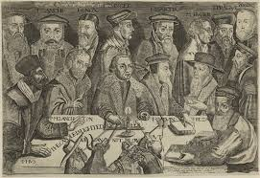
Calvinism
Protestant theological system of John Calvin and his successors, which develops Luther's doctrine of justification by faith alone and emphasizes the grace of God and the doctrine of predestination.

Slide 14
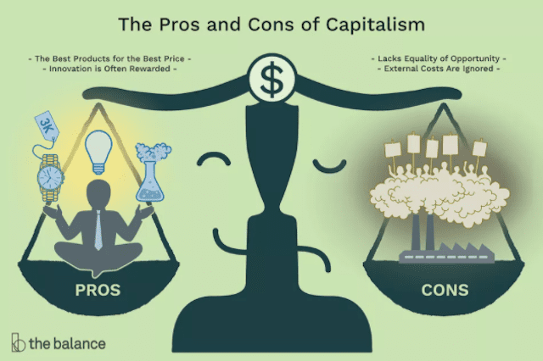
Capitalism
An economic and political system in which a country's trade and industry are controlled by private owners for profit, rather than by the state.

Slide 15
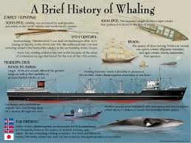
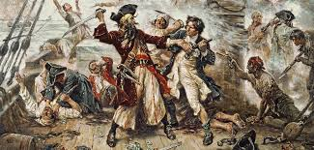
Next Class
Whaling (view)
Pirates (WSJ article)

Slide 16
Thoughts?
Thank YOU!

